Slide 1
Integration Tests Planning
I4SWT

Slide 2
Getting ready – mapping the dependency tree
Integration test planning is helped along using a dependency tree
Depicts inter-module dependencies in a tree-like structure
Does not depict an inheritance hierarchy, layering or the like
A depends-on B, C and D
B depends-on E and F
C depends-on F and G
D depends-on H and I
Some dependencies are obvious from sequence diagrams, object diagrams, state charts, etc.
Others require inspection (members, parameter types, ..)
Loops must be broken using stubs

Slide 3
Integration test patterns
Integration test patterns are used to plan and execute the integration tests.
This session covers the following patterns
Big Bang Integration
Bottom-up Integration
Top-down Integration
Collaboration Integration
Sandwich Integration

Slide 4
Big Bang Integration

Slide 5
Big Bang Integration
”Fire it up, see it fail”
Works (sometimes) for small, low-complexity, stable, systems
Only possible late in
development –
errors costly to fix
Works (sometimes) for small, low-complexity, stable, systems
Very low probability of detecting errors
Very little feed-
back

Slide 6
Bottom-up Integration

Slide 7
Bottom-up Integration
Reflects very ”engineering-like” mindset
No (few) stubs to develop
Requires many drivers at different levels
Easy to cover interfaces at all levels
Postpones test of critical control com-ponent interfaces

Slide 8
Top-down Integration

Slide 9
Top-down Integration
Needs lots of stubs (OK with isolation framework)
Early feedback on controller compo-nents
Hard to exercise low-level interfaces from the top
Facilitates concurrent HW and SW development

Slide 10
Collaboration Integration

Slide 11
Collaboration Integration

Slide 12
Collaboration Integration
Needs lots of stubs (OK with isolation framework)
Intuitive for users (may follow use cases)
Hard to exercise low-level interfaces
Participants not exercised separa-tely
Especially useful for higher-level system tests (component, subsystem)
Models iterative development with UCs as unit

Slide 13
Sandwich Integration

Slide 14
Sandwich Integration
Takes lots of planning
The best of top down and bottom up
Many of the disadvantages of TD and BU are alleviated

Slide 15
Dependency tree
Class diagrams (static information)
Remember polymorphic classes
Sequence diagrams (behavioral information)
Test cases for units
Which interfaces were defined
Which IFs were faked
Call trees? Manual or tool?
Reveals "tool classes", objects passed around
Dependency tree generator tool?

Slide 16
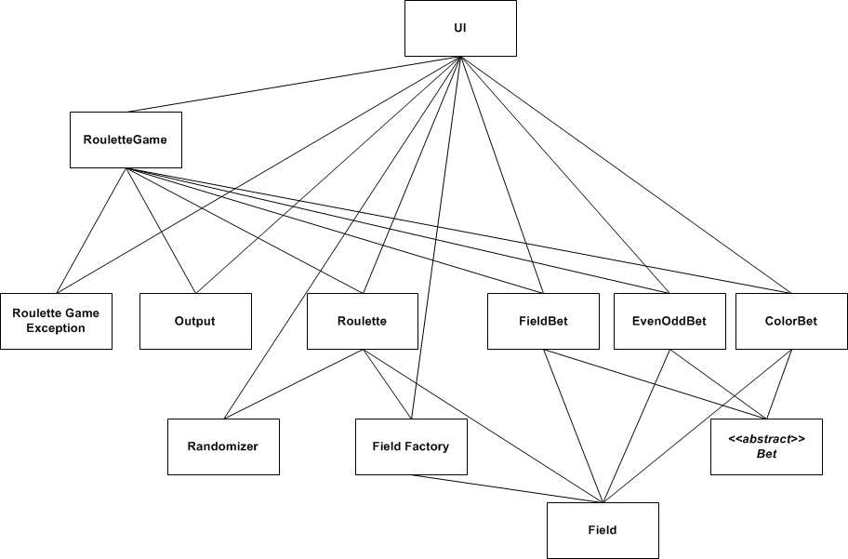
Dependency Tree
U
8
6
6
6
6
5
7
1
U
U
U
2
3
4
1
U

Slide 17
Bottom Up Plan
Step # | RouletteGame | Output | Roulette | FieldBet | EvenOddBet | ColorBet | Rando-mizer | Field Factory | Field
1 |  |  | T |  |  |  | S | X | X
2 |  |  |  | T |  |  |  |  | X
3 |  |  |  |  | T |  |  |  | X
4 |  |  |  |  |  | T |  |  | X
5 |  |  | T |  |  |  | X | X | X
6 | T | S | X | X | X | X | S | X | X
7 | T | S | X | X | X | X | X | X | X
8* | T | X | X | X | X | X | X | X | X
T: This module is included, it's the/a top module, and the one driven
X: This module is included
S: This module is faked: stubbed or mocked
*Step # 8 is difficult to automate!

Slide 18
Test cases
There is no interface coverage tool!
Partial use cases
Look in sequence diagrams
Original Unit Test cases for the top level unit(s)
(top level in the current integration step)
Does it make sense to reuse them all?

Slide 19
How to organize ITs
Organize your IT steps in one or more separate projects under the same solution as the units – one test fixture for each step

